Slide 1


Real Estate Predictive Analytics
Presented By:
Divya Sree Murali DE115
Jatin J DE120
Sivaprakash V DE138

Slide 2
Agenda
Project Overview
Project
Requirements
Solution Architecture
Demo
Results
Presentation Title

Slide 3
Project Overview
Uses Real Estate Sales 2001-2020 State of Connecticut dataset
To develop an end-to-end machine learning pipeline
Databricks used for data preprocessing & training ML model
Azure Data Factory orchestrates the workflow
By analysing features such as sale prices, locations, transaction details.
Pipeline predicts property types with high accuracy.
Shows the integration of Azure tools for automated real estate analytics.

Slide 4
Project Requirements
Azure Data Factory
ADF automates data movement and transformation, creating pipelines.
Azure Databricks
It is a cloud-based analytics platform that processes large datasets and runs machine learning models. It transforms and analyzes data stored in Azure Data Lake to generate insights efficiently.
Azure Data Lake storage
Azure Data Lake Storage is a scalable repository for both raw and processed data. It stores health data ingested via ADF, allowing Databricks to access and process the data for further analysis.

Slide 5
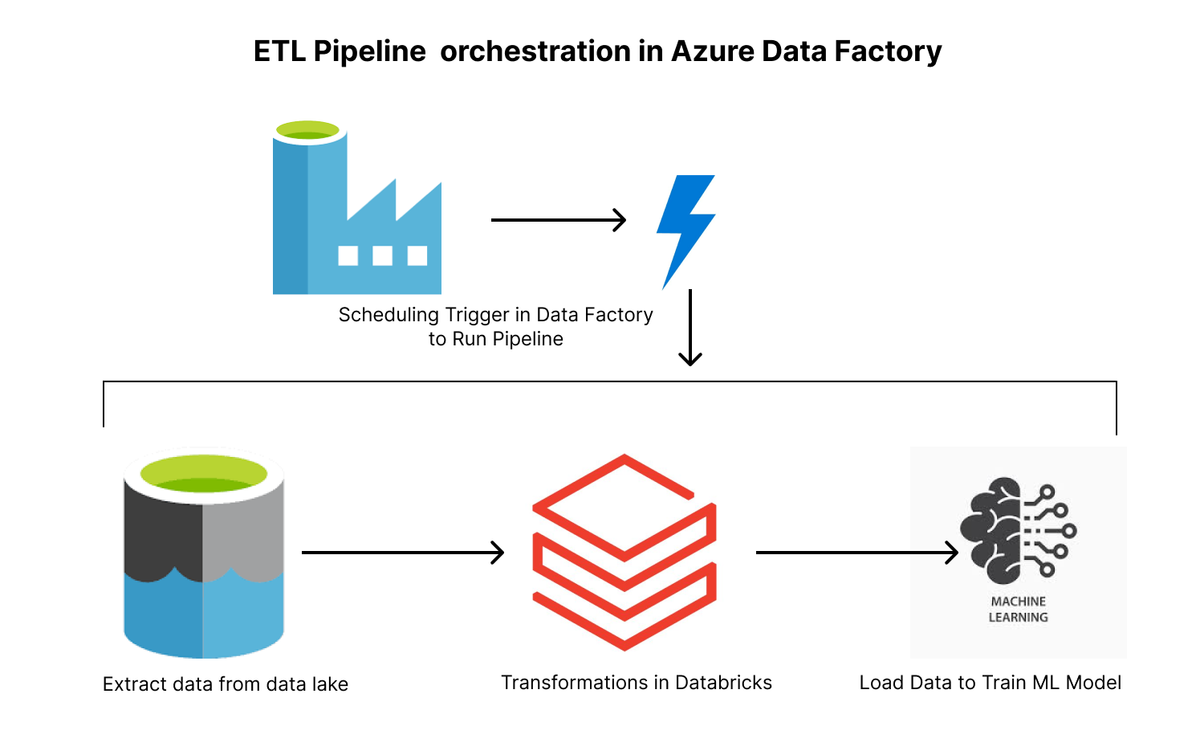
Solution Architecture
Data Preparation:
Raw Kaggle data stored in ADLS (Bronze).
Databricks processes data into Delta Tables (Silver).
Cleaned, transformed data moved to Gold Layer via ADF.
Model Deployment:
Random Forest model trained on Gold Layer data.
ADF orchestrates deployment on Azure Databricks.

Slide 6
Solution Architecture
Ingestion:
From Bronze Zone to Silver Zone
Transformation:
From Silver Zone to Gold Zone
ML Model:
Random Forest algorithm for property classification.
Orchestration:
Azure Data Factory for pipeline automation.

Slide 7
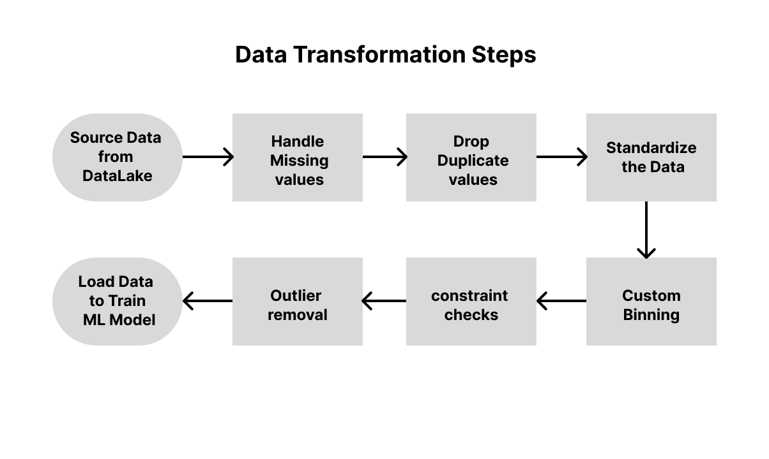
ETL & Feature Engineering

Slide 8
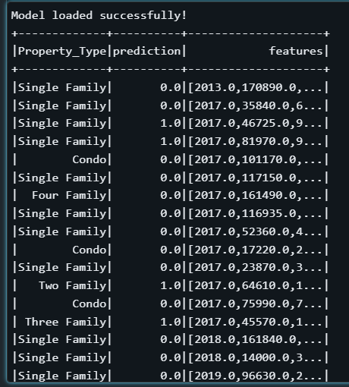
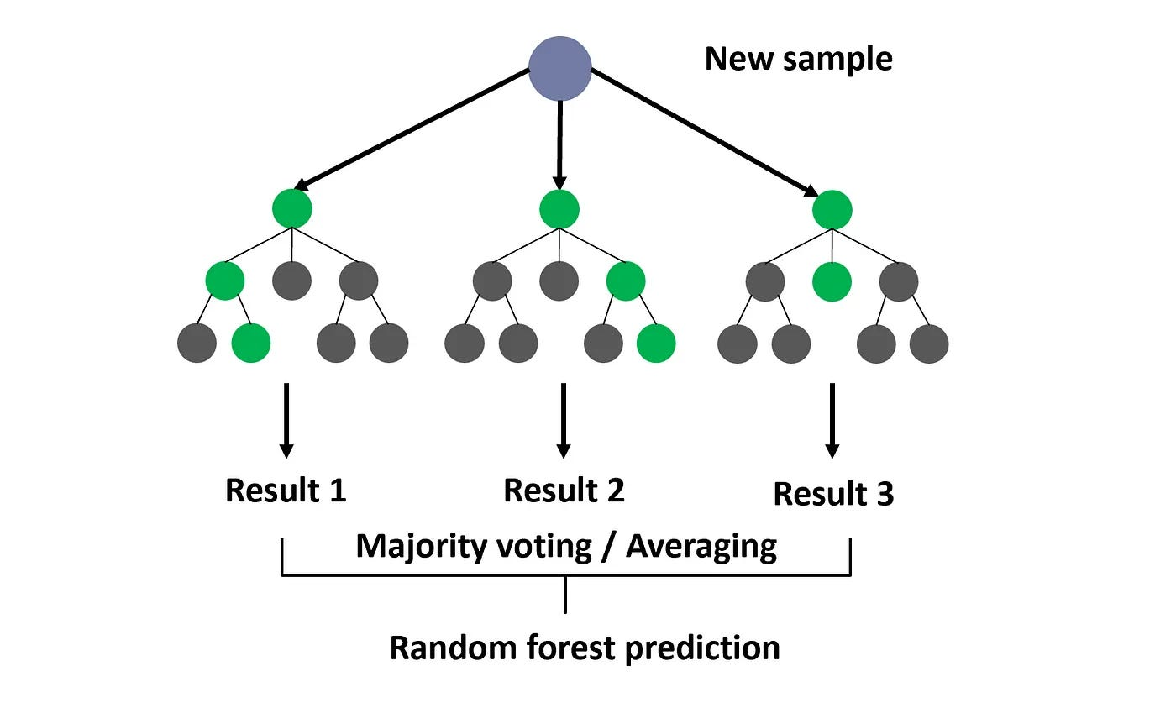

Demo
Trained with Random Forest algorithm.
Batch processing for predictions.
Performance evaluated using accuracy.

Slide 9
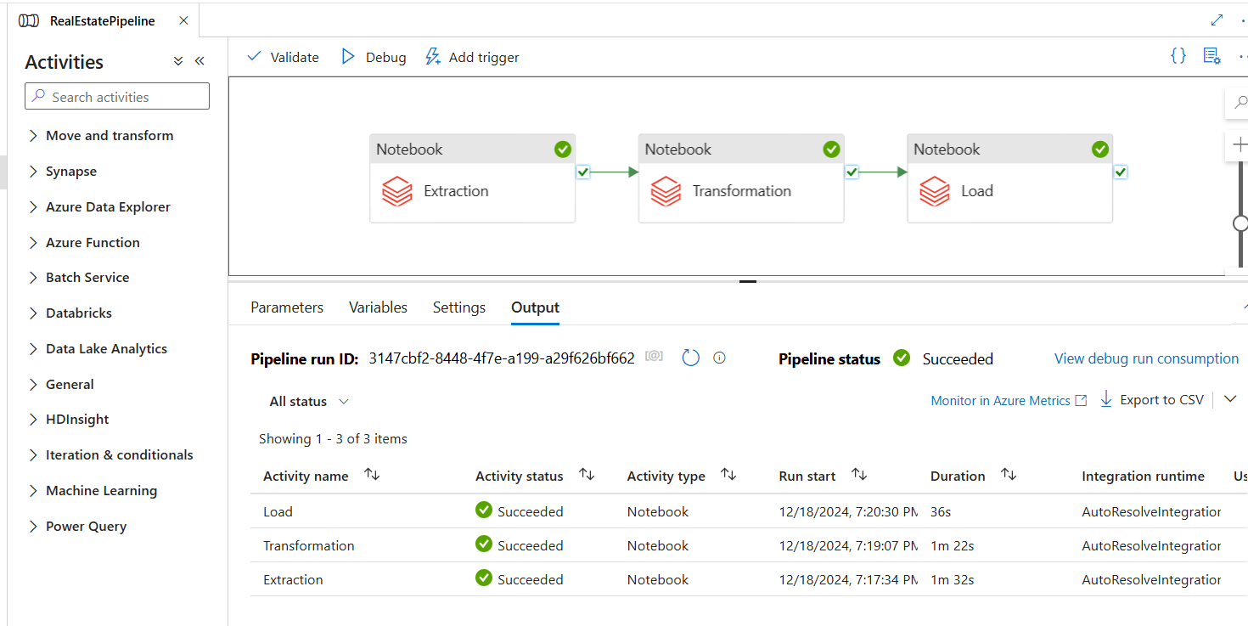
Results
Successfully built a scalable, automated ML pipeline.
Provided predictive insights for real estate data.
Demonstrated the power of Azure ecosystem integration.

Slide 10
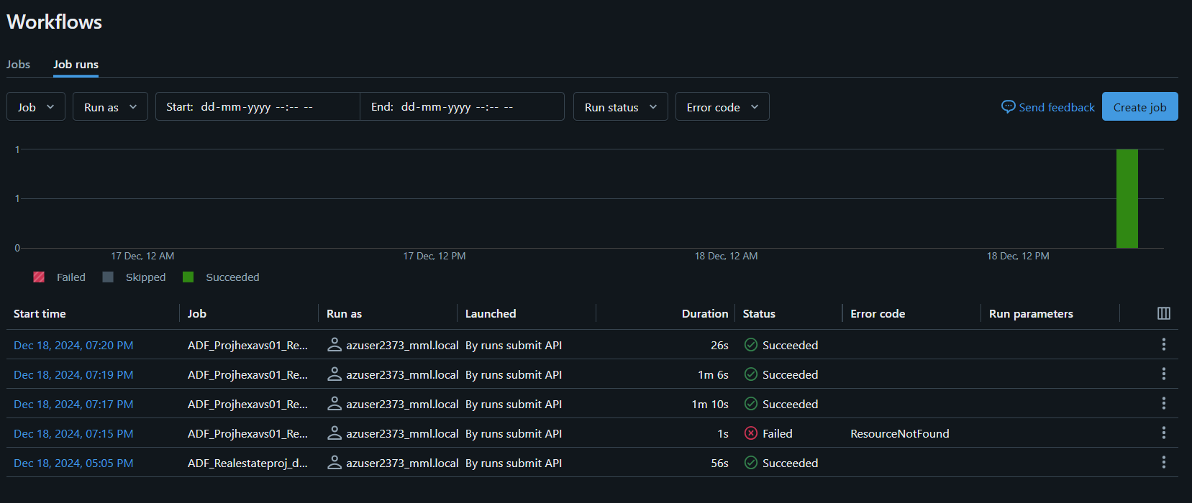
Results

Slide 11
Conclusion
The data preparation and model deployment pipeline utilizes Azure Data Lake Storage (ADLS), Databricks, and Azure Data Factory (ADF).
Efficiently process, clean, and transform raw data into valuable insights.
The Random Forest model is trained on the refined data in the Gold Layer
Deployed through ADF to ensure seamless integration and execution on Azure Databricks.
By that model for Real Estate activities, the property type can be predicted without hassle

Slide 12




Thank you

